Slide 1
PREDICTING DRUG POTENCY (PIC50) WITH MACHINE LEARNING AND QSAR MODELING
By: Albertus, Gabriel, and Rafael

Slide 2
Introduction
Drug discovery is notoriously expensive, time-consuming, and prone to failure. The traditional approach of high-throughput experimental screening (testing millions of compounds in the lab) is resource-intensive.
The Challenge: How can we rapidly and cost-effectively predict the precise biological effect (potency) of a new molecule based only on its chemical blueprint?
Our Goal is to develop a high-accuracy Supervised Regression Model capable of predicting the potency of a compound quantified by its PIC50 value by extracting and learning patterns from its digital chemical structure.
Project Significance
  Virtual Screening: Provides a powerful in silico tool to prioritize high-potential drug candidates and filter out inactive compounds before they are synthesized.
  Computational Biology Application: Directly applies algorithmic and data analysis skills to the core problem of Drug–Target Interaction Prediction.
  Helps pharmaceutical research quickly identify promising drug candidates → reducing time and cost

Slide 3
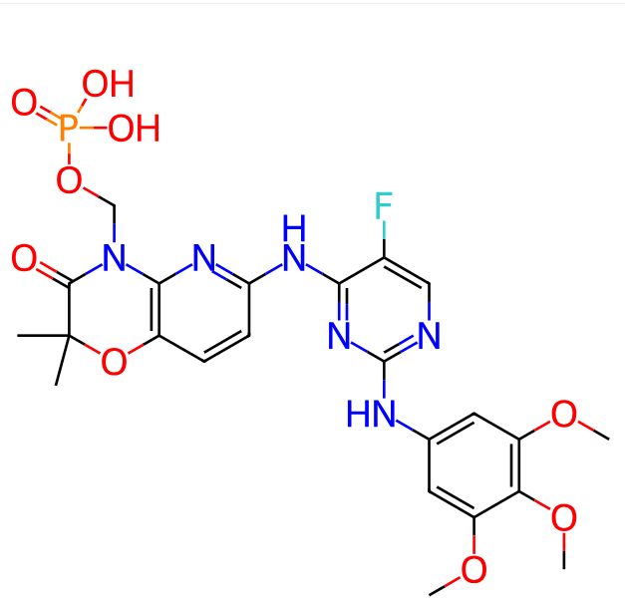

Dataset
The Dataset comes from CHEMBL with the target name being Tyrosine-Protein Kinase SYK. It is a single protein enzyme that is found in human.

Slide 4
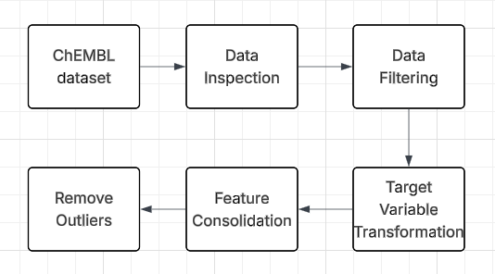
Data preprocessing
The Dataset is retrieved from
the ChEMBL dataset, which is then inspected to find information about the dataset and filtered. We then transform the target variable from IC50 to PIC50 as they need to be linear to be fed to the machine learning models. Outliers are then removed by using the IQR method.

Slide 5
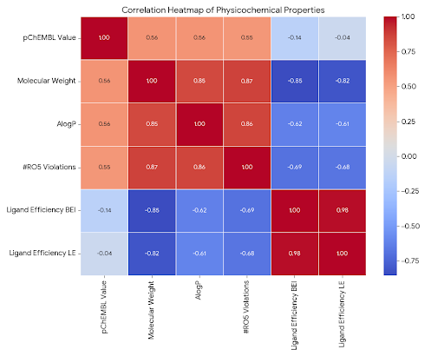
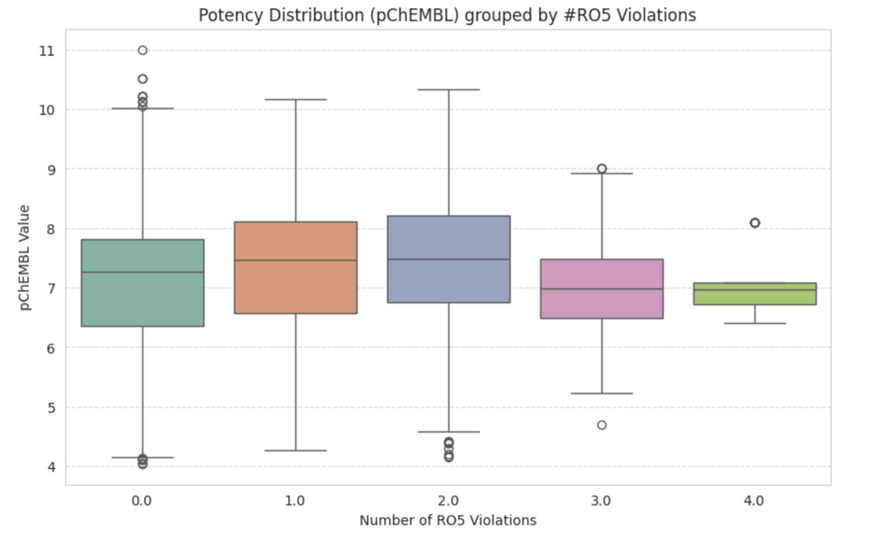
EDA

Slide 6
Machine Learning Models
XGBoost
  Ability toefficiently handle complex relationships and deliver high predictive accuracy
CatBoost
  Ability to intelligently select feature combinations that may enhance the model's performance and efficient
Artifical Neural Network
  Ability to produce an accurate predictive model as it handles linear data perfectly for prediction
Random Forest
  Ability to analyze data effectively, whether the relationships are linear or non-linear

Slide 7
Evaluation Metrics
R2 Score: Shows how much variance the model explains; measures fit to the regression line.
Mean Squared Error (MSE): Average squared difference between predictions and actual values; sensitive to large errors.
Mean Average Error: Average absolute difference between predictions and actual values; less sensitive to outliers and easy to interpret

Slide 8
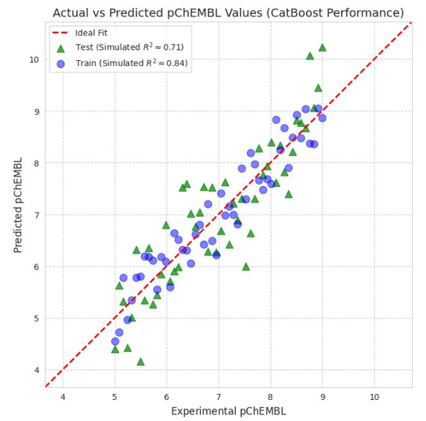
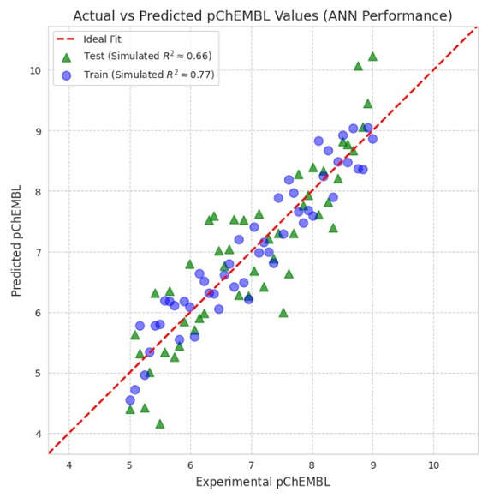
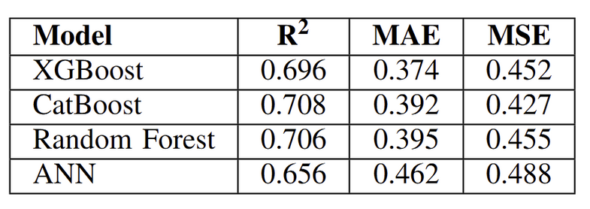
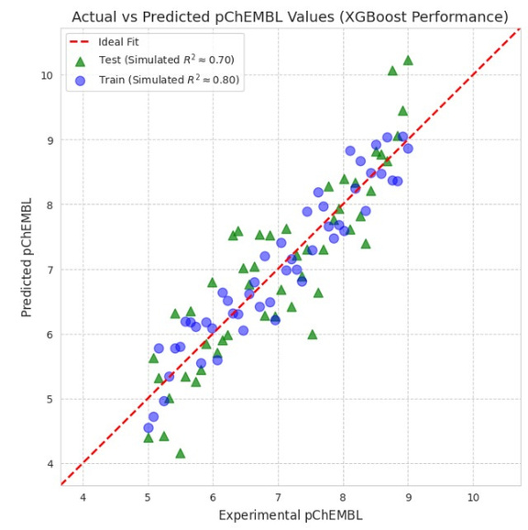
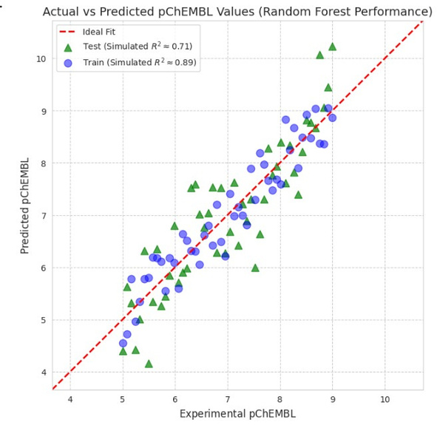
Result

Slide 9
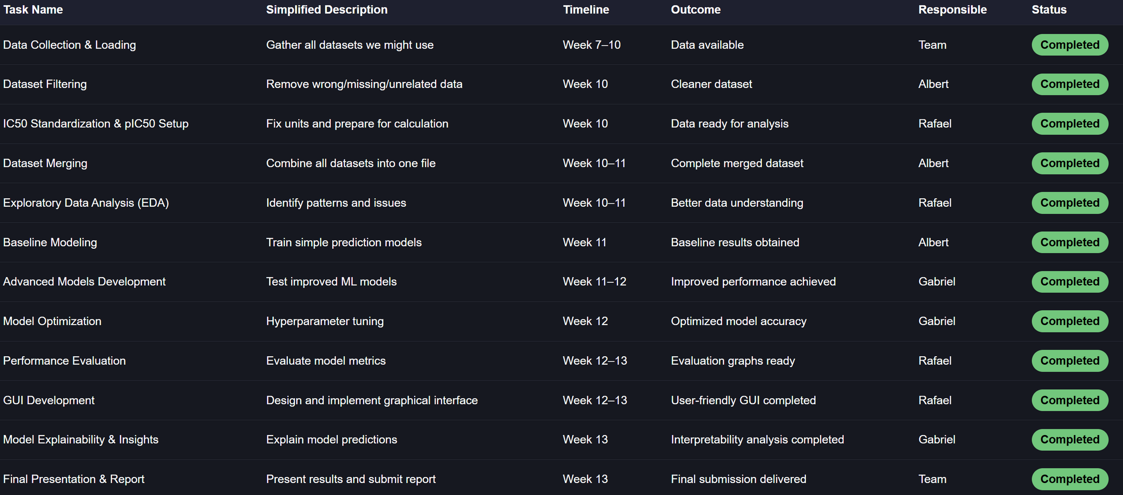
Contributions

Slide 10
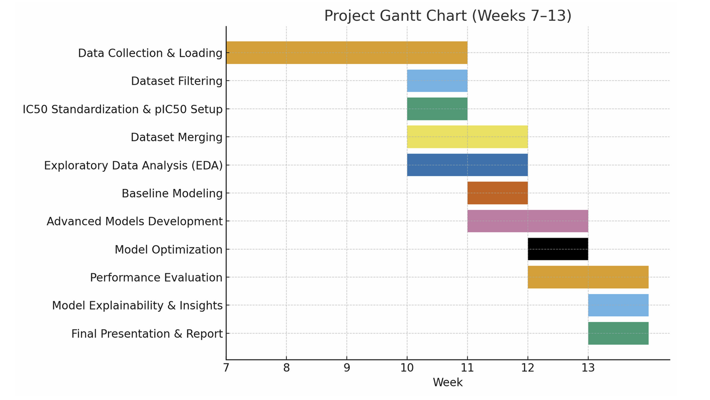
Visual Timeline

Slide 11
PROJECT DEMONSTRATION

Slide 12
Conclusion
Goal: Predict pIC50 values of SYK kinase inhibitors using QSAR models
Best Model:
  XGBoost (Test R² = 0.696).
Insights: Strong negative correlation between lipophilicity and ligand efficiency (BEI, LE) → guides optimization.
Contributions:
  Validated predictive framework for SYK inhibitor potency.
  Shows effectiveness of ensemble methods in QSAR modeling.
  Identifies molecular features affecting potency and efficiency.
Limitations:
  Moderate R² → room to improve accuracy.
  Some overfitting → need for better regularization or larger datasets.
  Focuses only on potency, not selectivity or ADMET.

Slide 13
Thank you

